Slide 1
COMP6230
Expected the Unexpected
Oliver Bills
ofb@ecs.soton.ac.uk

Slide 2
If this is the answer…
Sponsored by…
What was the question?

Slide 3
1.9 billion
UK Cybersecurity investment
Notes:
Philip Hammond added that hostile "foreign actors" were developing techniques that threaten the country's electrical grid and airports.
The warning came within a speech describing how the government plans to spend a previously announced £1.9bn sum on cybersecurity.

Slide 4
2,337
Putin’s aides messages compromised
Notes:
Ukrainian activists have compromised 2,337 messages in the Microsoft Outlook accounts of two assistants to a top aide of Vladimir Putin

Slide 5
911
Phoenix Teenager’s unintentional DDOS
Notes:
A Phoenix teenager mistakenly tweeted a link to JavaScript exploit which forced iOS devices to automatically dial and re-dial 911

Slide 6
Today
Using helpful utilities
Not Internet Explorer or Edge!
Firefox or Chrome
Web developer toolbar
Firebug/Chrome developer tools
Firecookie/EditThisCookie
Using assisted tools
Intercepting Proxies
Making use of what we know
A look at Rob the Shop using our new skills!

Slide 7
Rob the Shop
Did you manage to Rob the Shop?
Was a brief introduction to the basics of some of the vulnerabilities we looked at
Sometimes it really is this simple!
But it is going to get harder…
What vulnerabilities did we find?

Slide 8
Rob the Shop: Vulnerabilities
Information exposure
SQL injection
Authorisation bypass
Parameter manipulation/Application logic
XSS
Insecure cookie authorisation

Slide 9
Starting out
Set up our environment
Google Chrome or Firefox
Web developer extension
Web developer tools/Firebug
EditThisCookie
Proxy swithcer
Burp Suite
Dirbuster

Slide 10
Web Developer Toolbar
Disable things on the page (e.g. javascript)
Show things that would otherwise be hidden
View form details
View and edit cookie details
Manipulate forms directly

Slide 11
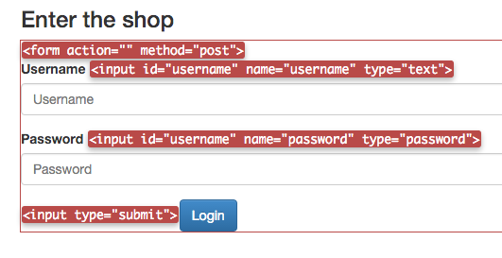
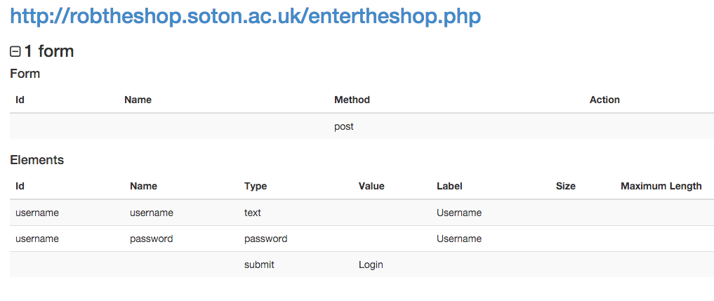
View form details
View form details on the page
View a summary of the form, including all fields
Edit all form fields (including hidden fields)
Why is this useful?

Slide 12
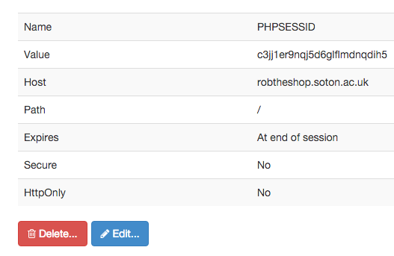
View and edit cookies
View all the cookies from this domain
Edit cookies
Clear and disable cookies
Why is this useful?

Slide 13

Disable functionality
Many websites rely on javascript, cookies, sessions
But how do they handle it when they’re disabled?
They can break in spectacular ways…
http://turnitin.com/
That’s bad form!

Slide 14
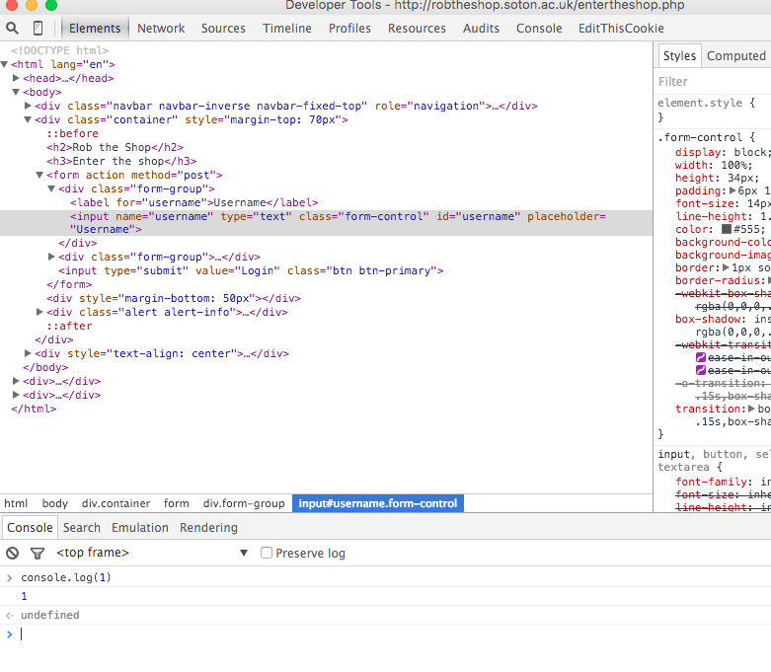
Web Developer Tools
Allow us to explore and manipulate the DOM
The make-up of the page

Slide 15
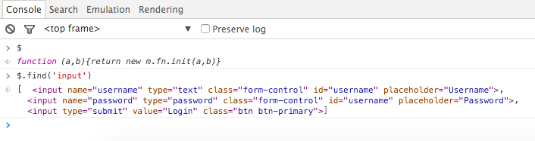
Web Developer Tools
Allows us to execute javascript code in the context of the page
Allows us to view the console – any errors?

Slide 16
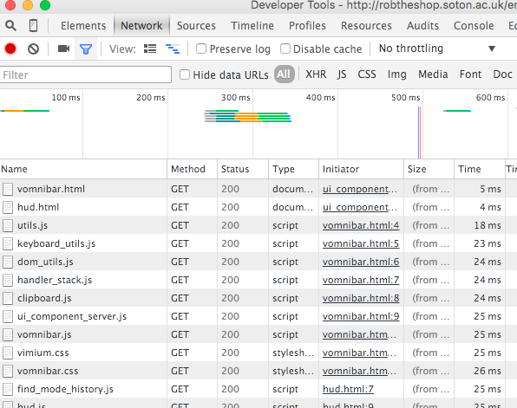
Web Developer Tools
Allow us to view the resources that the page loads

Slide 17
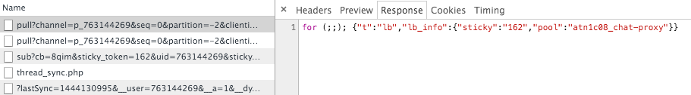
Web Developer Tools
Lets us watch AJAX requests, the request data and the responses
Learn about how the internal communication works
We can send our own messages…

Slide 18
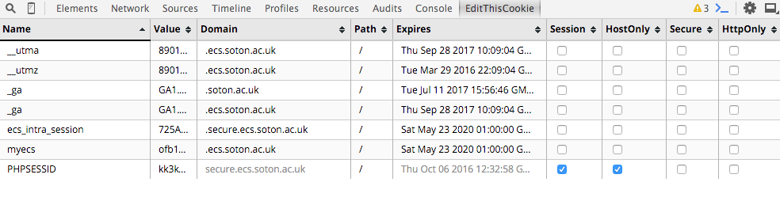
Editing Cookies
View what cookies are being set
What properties the cookies have
Ability to edit cookie content

Slide 19
Burp Suite
Burp suite is an intercepting proxy
While you browse, everything passes through it
It collects information
It allows you to track what you have done
It allows you to review previous requests and responses
Most importantly, it lets you manipulate everything!

Slide 20
Burp Suite
You
Web Server

Slide 21
Burp Suite
Burp Suite
You
Web Server

Slide 22
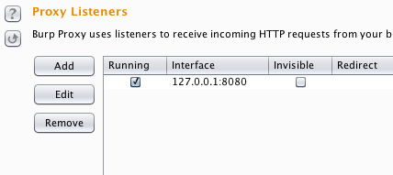
Intercepting Proxy
It listens on a port on your computer, typically 8080
Redirect your security testing traffic through that port
It’ll then go through the proxy

Slide 23
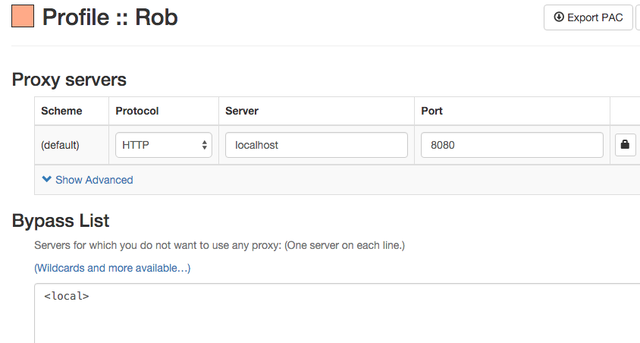
Setting up our proxy

Slide 24
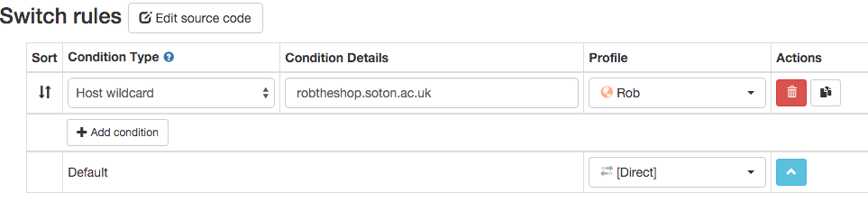
Setting up our proxy

Slide 25
The five levels of attack
Exploiting the obvious
Hiding in plain sight
Following the subtle clues
Informed guessing
Brute forcing
The higher up the list, the better!

Slide 26
The five levels of attack
Exploiting the obvious
A bug in the application
Exposed functionality
Out of date software
Hiding in plain sight
Following the subtle clues
Informed guessing
Brute forcing
Notes:
Can they really be that simple? If you take a look at some of the university systems, you’ll find they can be. Wait, I probably shouldn’t say that.

Slide 27
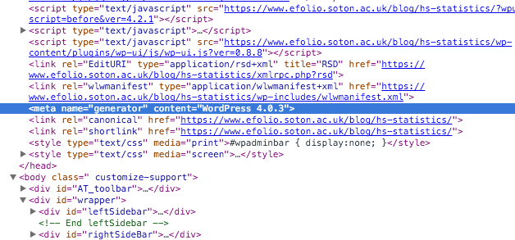
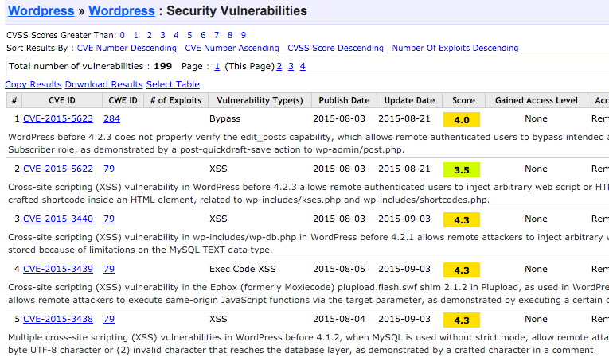

Slide 28
The five levels of attack
Exploiting the obvious
Hiding in plain sight
Parameter manipulation
Exposed areas of the application
Files left behind, developer comments
Security through obscurity
Following the subtle clues
Informed guessing
Brute forcing

Slide 29
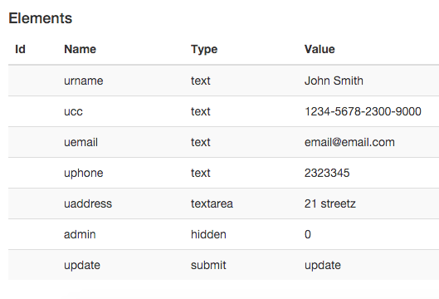

Slide 30
The five levels of attack
Exploiting the obvious
Hiding in plain sight
Following the subtle clues
Things that shouldn’t be there – is it needed?
Things that don’t behave as expected
Strange ways of doing things
Anything that looks suspicious
Informed guessing
Brute forcing

Slide 32
The five levels of attack
Exploiting the obvious
Hiding in plain sight
Following the subtle clues
Informed guessing
What do we know about the application so far
What have we noticed
What conventions are in use
What framework are they using
They are logical – so we should be logical
Brute forcing

Slide 33
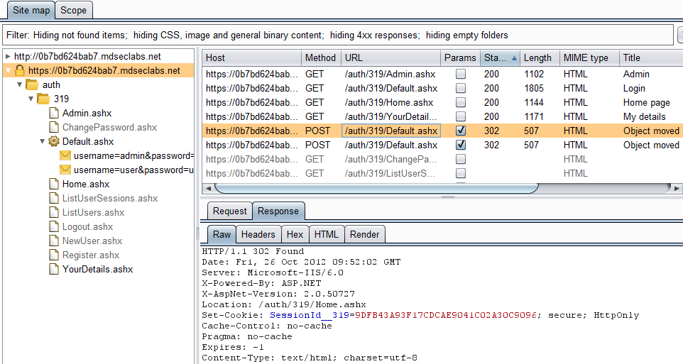

Slide 34
The five levels of attack
Exploiting the obvious
Hiding in plain sight
Following the subtle clues
Informed guessing
Brute forcing
Not ideal!
Session guessing
Passwords

